Slide 1
The analysis of the result section of Modern Language Journal Result Analsis
reporter: 韩昊辰 G1

Slide 2
Prominent Feature of the result section
(1) Logical arrangement
(2) Virsuals
(3) Contextual Analysis
A.Prominent Features
B.Linguistic Features
(1) Limited content
(2) Past & Present tense
(3) None Phrases

Slide 3
The Structural Features
A.

Slide 4
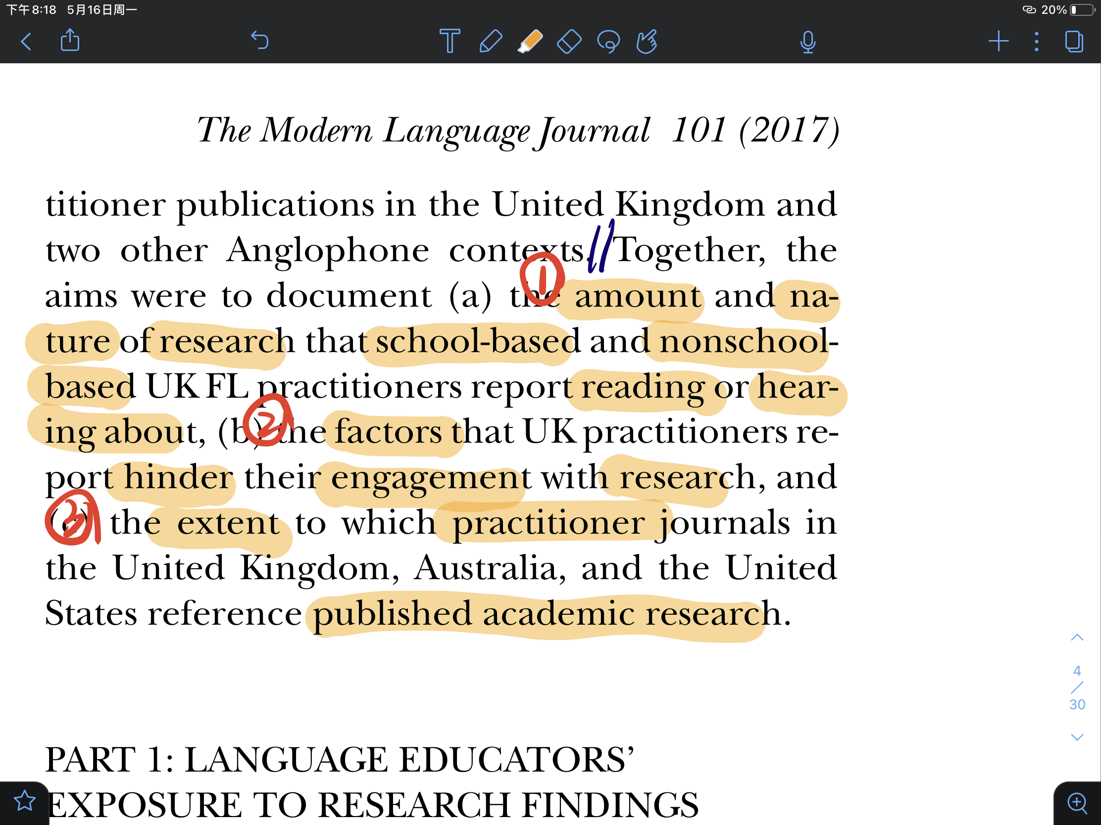
A.The Structural Features- (1) Logical arrangement
The research question (in yellow):
amount
nature
reading
hearing
hinder
publish extent

Slide 5
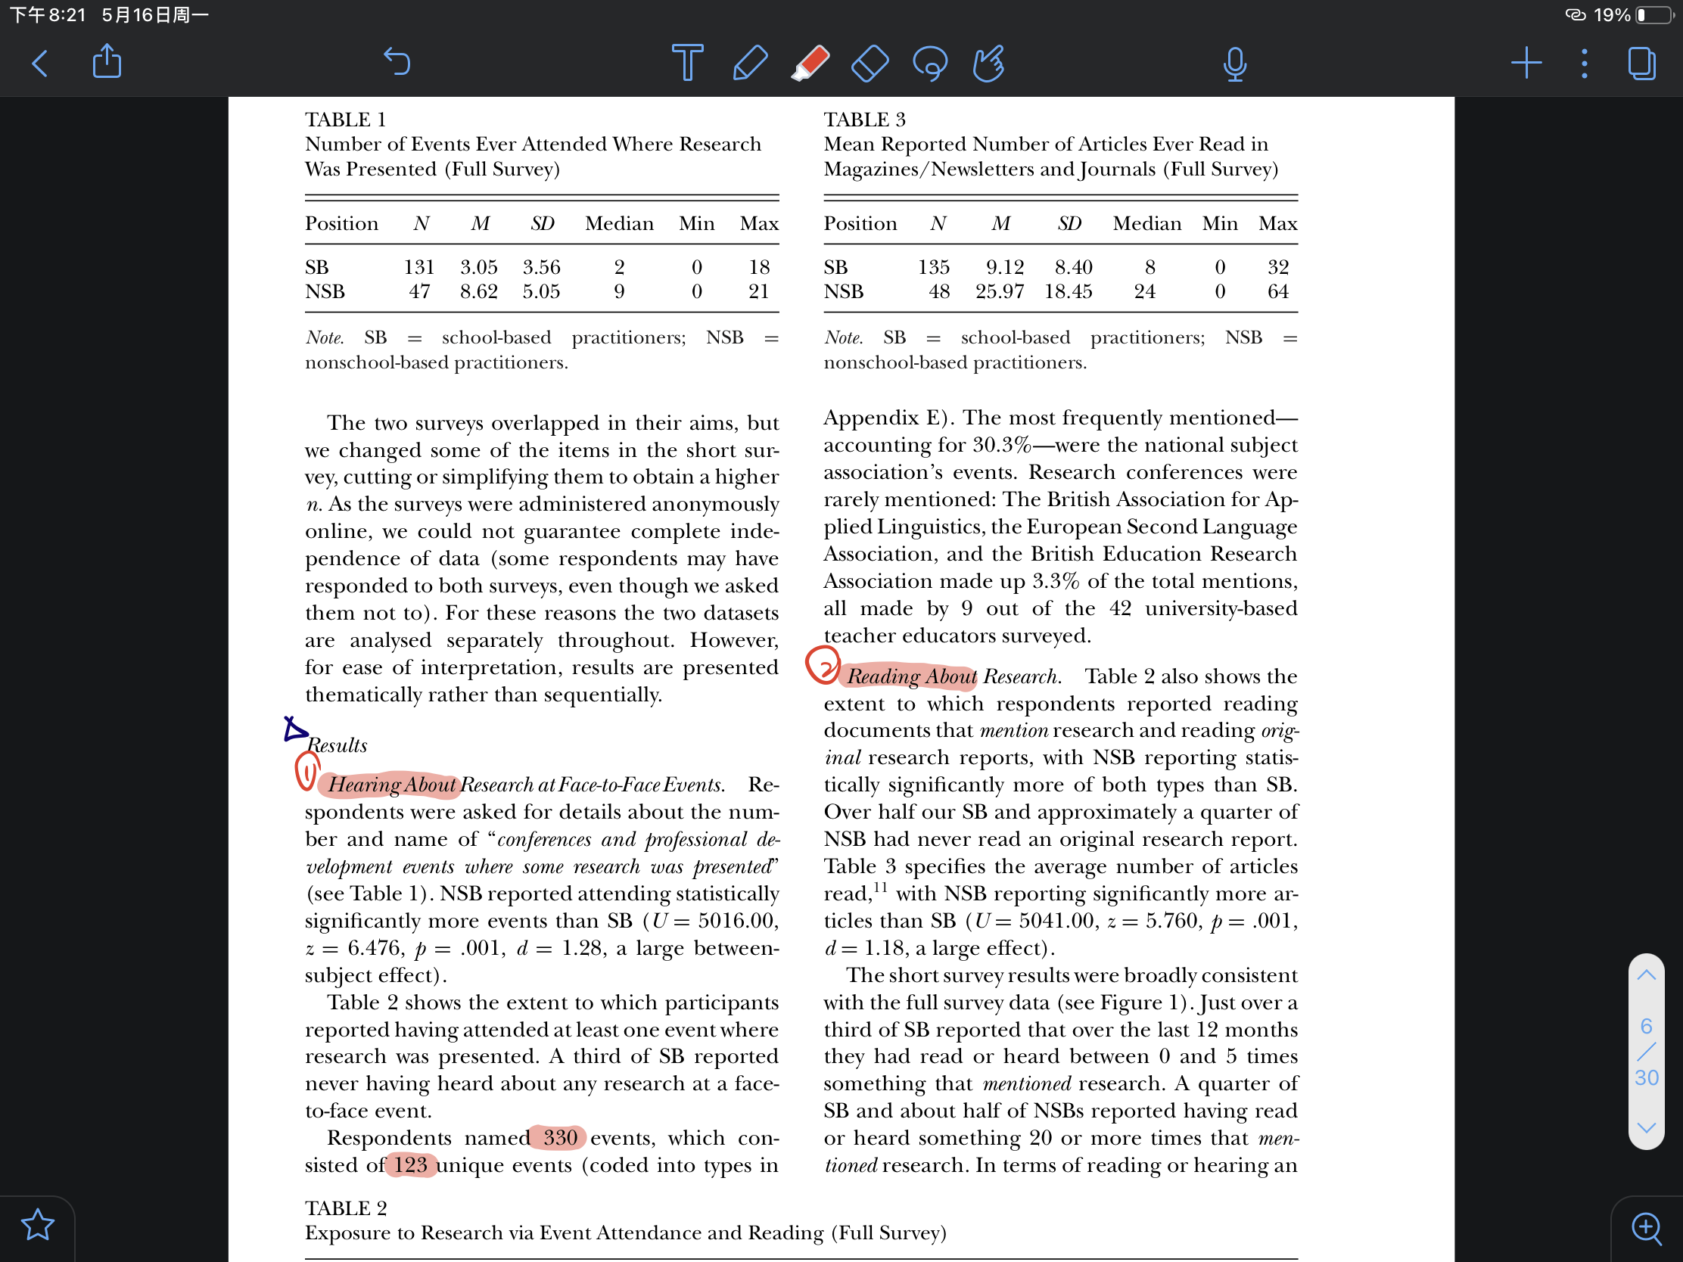
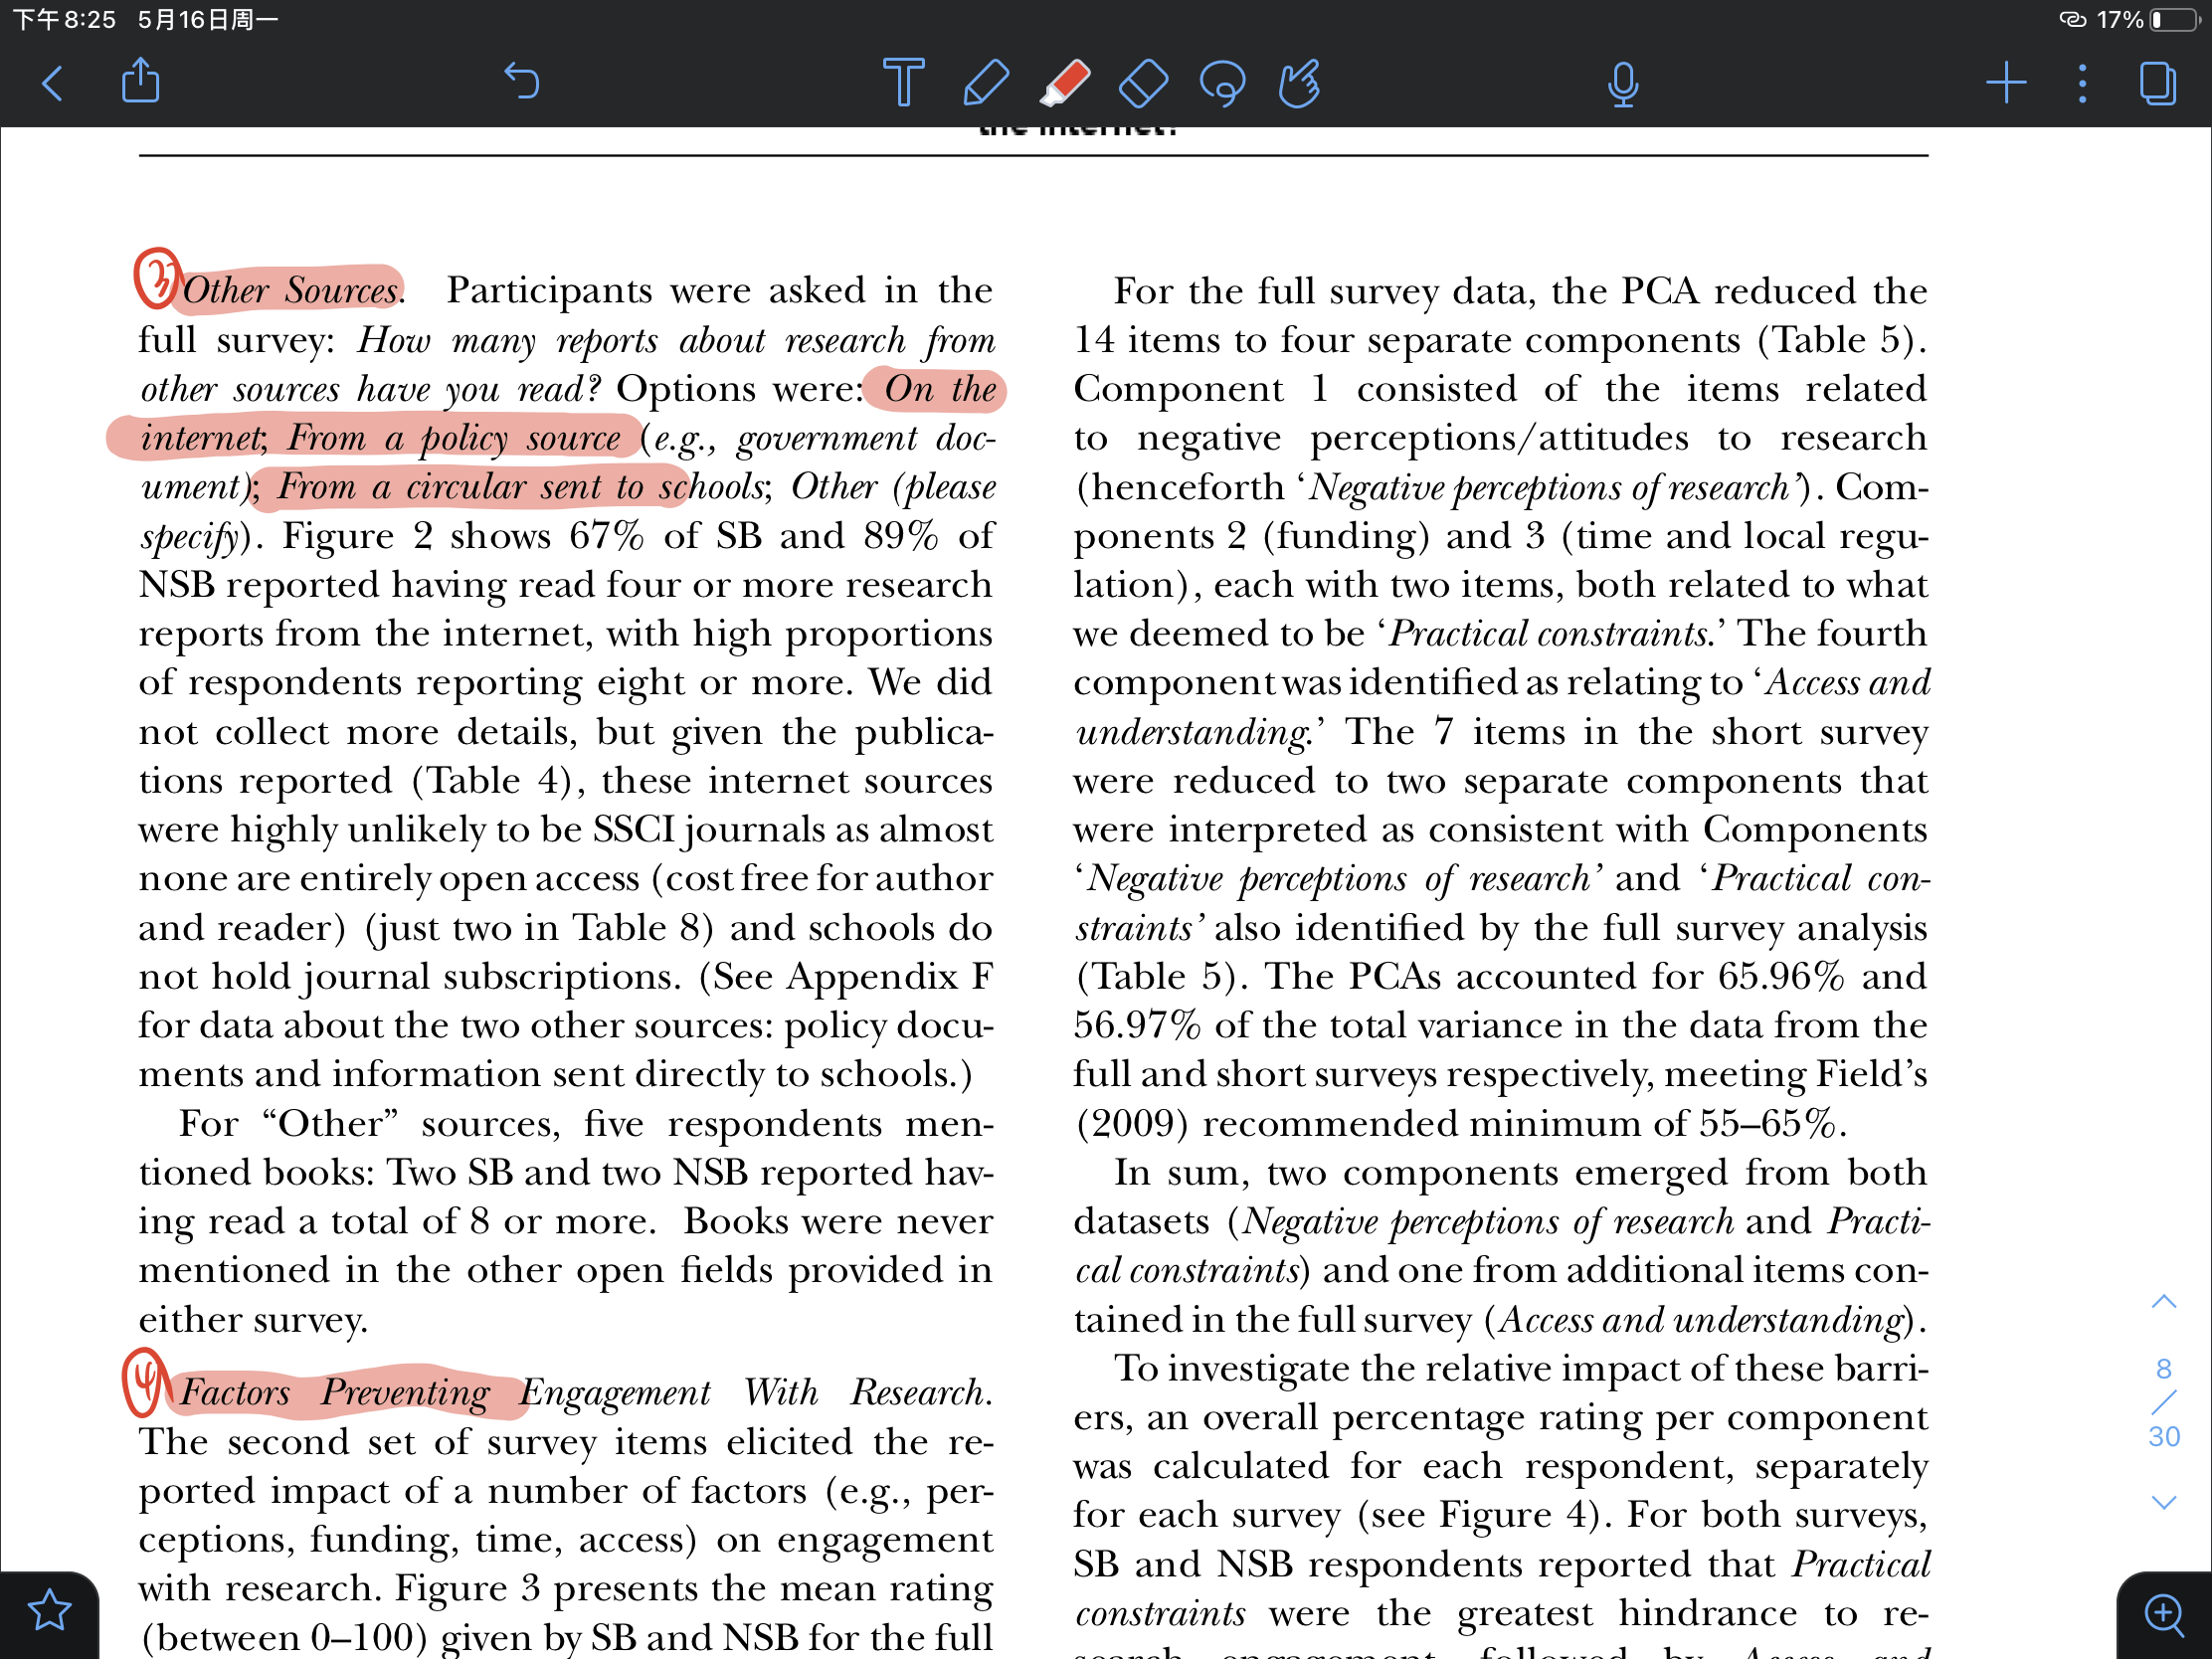
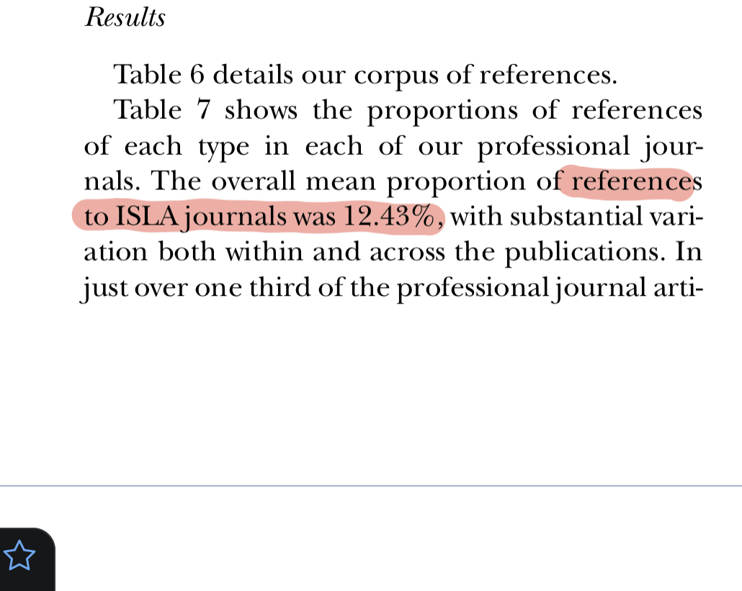
A.The Structural Features-(1) Logical arrangement
The type of data presented by the lecture addresses the research question, by order (in red)
nature (where research are from)
reading
hearing
publish extent
hinder
amount

Slide 6
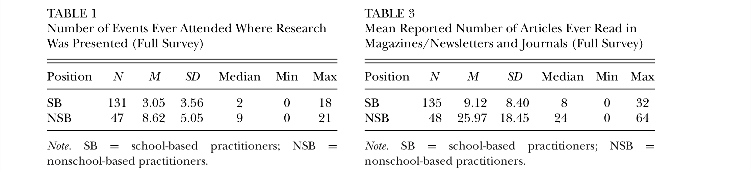
A.The Structural Features- (2) Virsuals
The data is presented in tables, charts, graphs and other figures.

Slide 7
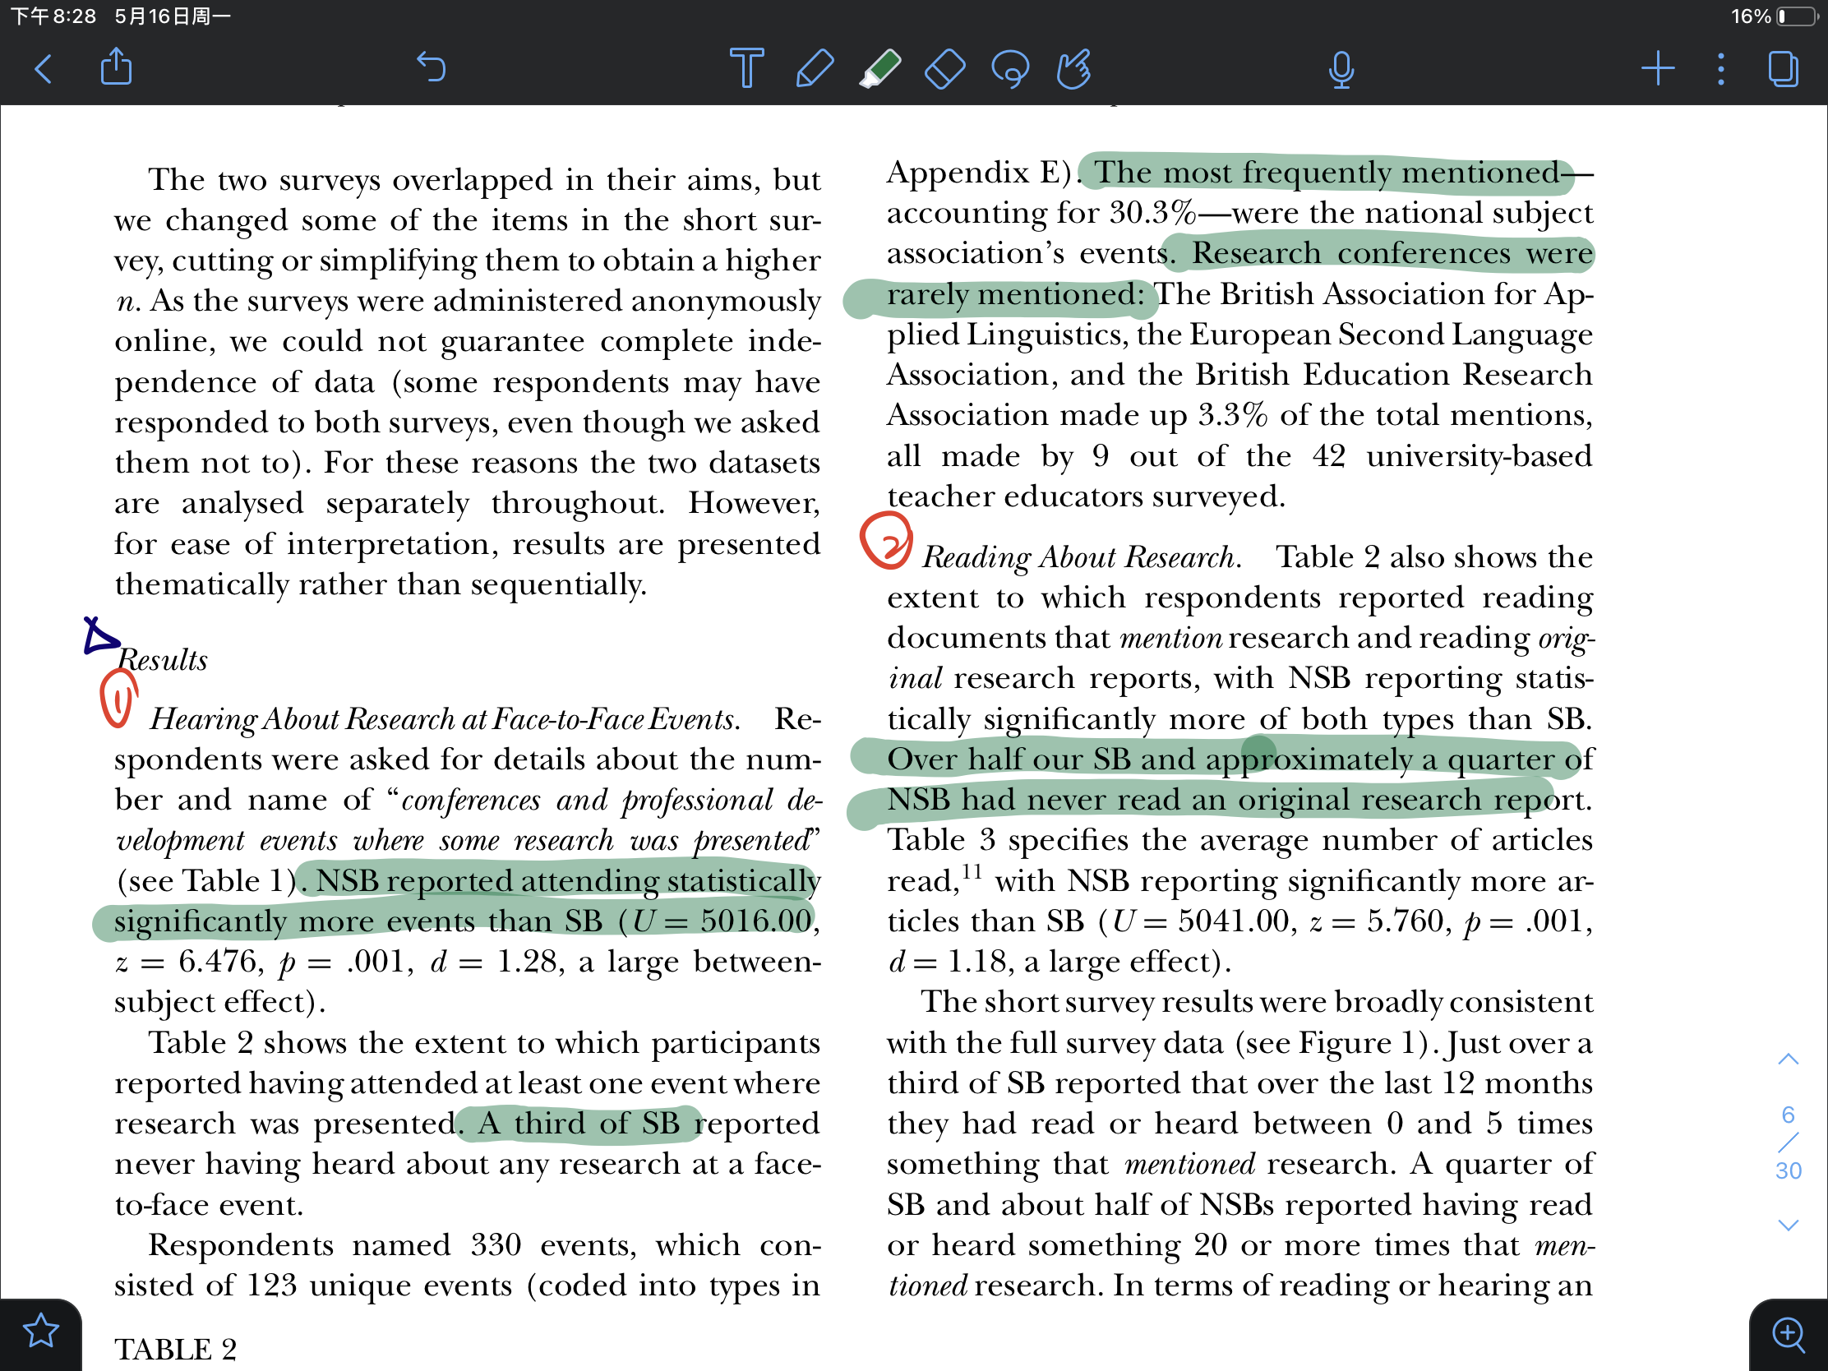
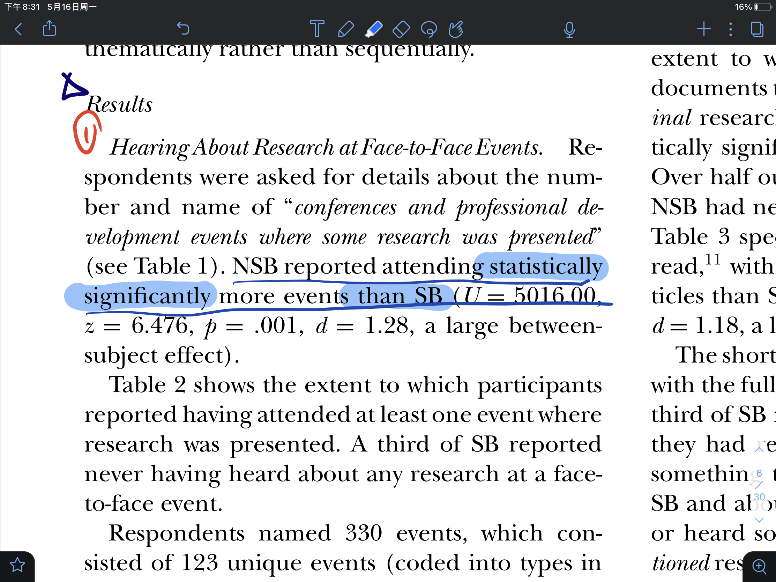
A.The Structural Features- (3) Contextual Analysis
Not a list of data but combined with
contextual anaylisis (in green)
Direction Magnitude

Slide 8
The Linguistic Features
B.

Slide 9
B.The Linguistic Features
(1) Limited content
include: 1,direct findings and outcomes
not include: 1,author’s subjective judgment
2,methods of analysis
3,background
4,interpretation of the result

Slide 10
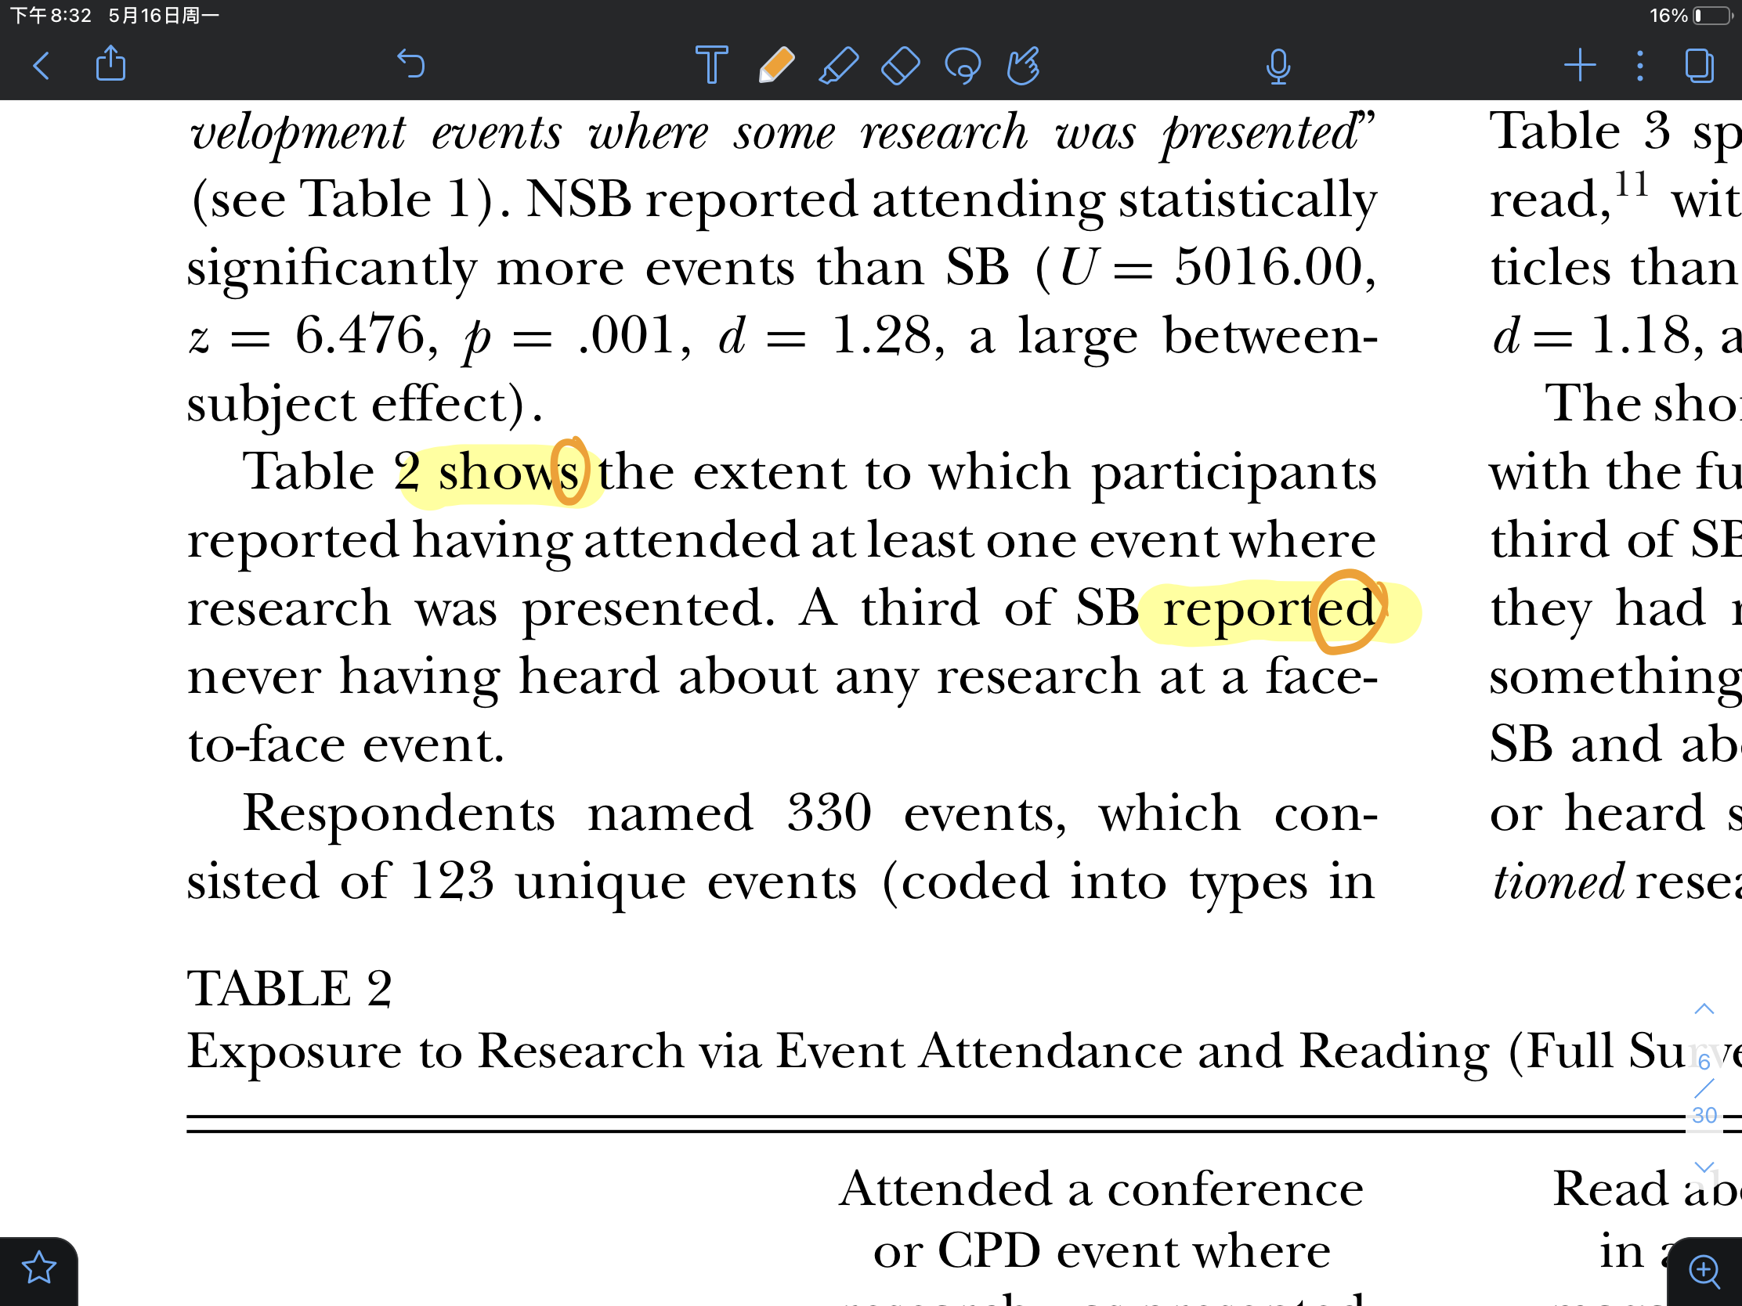
B.The Linguistic Features- (2) Present & Past tense
Present tense —— Refer to virsuals
Past tense —— Refer to experimental data (in yellow)

Slide 11
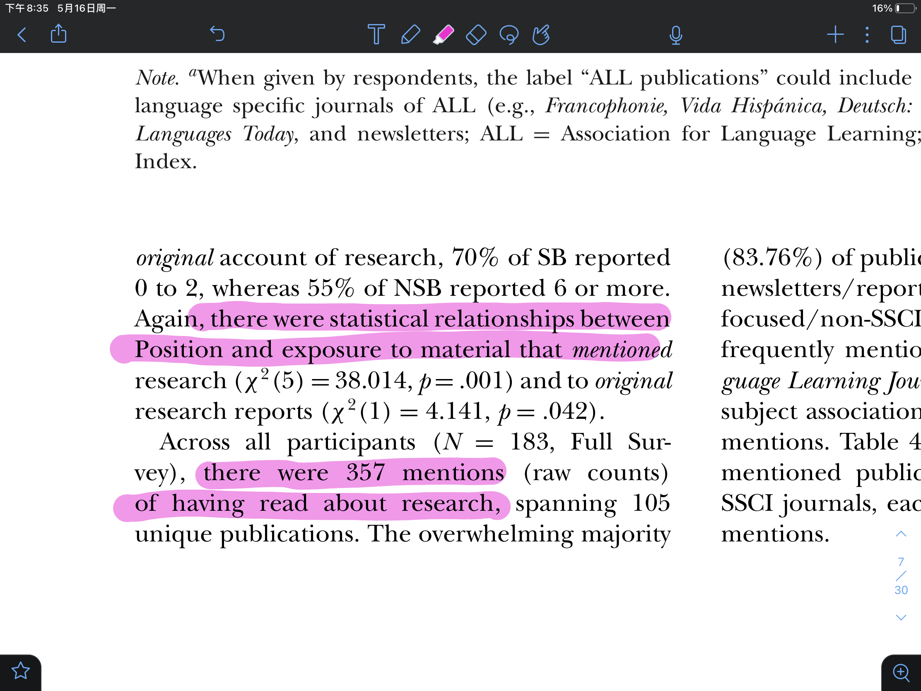
B.The Linguistic Features- (3) None phrases
none phrases ( in purple )
result
Avoid using “I”,”We”
The article flow better and become
more professional and objective
Not be like: position and exposure are related
or
having read about ... were mentioned

Slide 12
Thanks for listening！
reporter: 韩昊辰 G1

